Slide 1
Programming Fundamentals
Course Code: CS-111
Course Instructor: Isra Naz

Slide 2

CLO Covered in this Lecture:
CLO2 - Applies basic programming concepts through hands-on experience with C++ syntax and structure.

Slide 3

Goal for today:
1D Arrays
Introduction
Declaring 1-D Array
Initializing 1-D Array
Using 1-D Array

Slide 4
Arrays - Introduction
Just like we group up similar things in everyday life, we also group together data items in computer languages.
Data items of the same type need to be grouped together.
The most basic mechanism for doing so in C++ is the array.
Arrays hold items of simple types like int, char, float or the user defined types like structures and objects.
In other words, an array is a consecutive group of memory locations that have the same type.

Slide 5
Real life application of Arrays
Arrays are the simplest data structures that stores items of the same data type.
A basic application of Arrays can be storing data in tabular format.
For example, if we wish to store the contacts on our phone, then the software will simply place all our contacts in an array.

Slide 6
Advantages of Arrays
Arrays can store a large number of value with single name.
Arrays are used to process many value easily and quickly.
The values stored in an array can be sorted easily.
The search process can be applied on arrays easily.

Slide 7
Types of Arrays:
One-Dimensional Array
Two-Dimensional Array
Multi-Dimensional Array

Slide 8
1-D Array
A type of array in which all elements are arranged in the form of a list is known as 1-D array or single dimensional array or linear list.
The process of specifying array name, length and data type is called array declaration.
Declaring 1-D Array:
data_type identifier[length];
Data _type:
Identifier:
Length:
Data type of values to be stored in the array. Name of the array.
Number of elements.

Slide 9
Example
int marks[5];
Index of each element
0 | 1 | 2 | 3 | 4
Array name marks

Slide 10
One-D array Intialization
The process of assigning values to array elements at the time of array declaration is called array initialization.
The values are separated with commas and enclosed within braces.
A syntax error occurs if the values in braces are more than the length of array.
If the number of initial values is less than the array size, the remaining array of elements are initialized to zero.
Syntax:
data_type identifier[length]={ List of values };

Slide 11
One-D array Intialization
Example:
int marks[5] = {70, 54, 84, 96, 49};
Index of each element
0 | 1 | 2 | 3 | 4
70 | 54 | 84 | 96 | 49
Array name marks
An array size can be omitted when it is initialized in the declaration.
The compiler determines the size of array according to initialized values.
i.e. int age [ ] = { 23, 27, 15, 32, 40, 3, 85, 20, 9}
The size of array is 9.

Slide 12
One-D array Intialization
Example:
char a[10]={'a', 'b', 'c', 'd', 'e', 'f', 'g', 'h', 'i', 'j'};
char st[10]={"pakistan"};

Slide 13
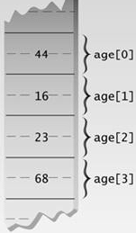
Arrays - fundamentals
Array Elements
The items in an array are called elements.
All elements have same data type.
Figure shows memory snapshot of array elements of array age of size 4 and type int.
Note that the numbering of elements begins with 0.
The position number of array element formally called index or subscript.

Slide 14
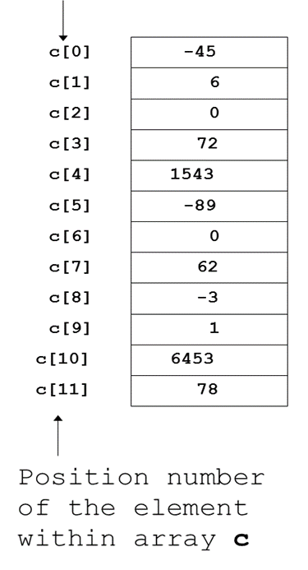
Arrays
An array is a sequence of objects of same data type.
Objects of an array are called elements.
Group of consecutive memory locations
To refer to an element, specify
Array name
Position number(index number)written in subscript[]
First element at position 0
n element array named c has index values from
0 to n-1:
c[ 0 ], c[ 1 ]...c[ n – 1 ]

Slide 15
Reading Strings
void main()
{
char name[20], address[30];
cout<<"Enter name ";
cin>>name;
cout<<"Enter Address ";
cin>>address;
cout<<"Name = "<<name <<"\nAddress = "<<address;
getch();
}
Note : Does not read white spaces

Slide 16
Accessing element of array
Individual Element:
array_name[index];
Example:
int marks[5];
marks[0]= 20;
marks[1]= 50;
marks[2]= 70;
marks[3]= 80;
marks[4]= 90;
marks[0]
marks[2]
marks[4]
marks
20 | 50 | 70 | 80 | 90
marks[1]
marks[3]

Slide 17
Accessing element of array
Using Loop:
int marks[5];
for(int i = 0; i<=4; i++)
{
cout<<“Enter marks:”;
cin>>marks[i]; // store elements in an array
}
for(int i = 0; i<=4; i++)
{
cout<<marks[i]; // accessing array elements
}

Slide 18
Example
Input five integers from the user and stores them in an array. It then displays all values in the array using loops.

Slide 19
Example
Input five integers from the user and stores them in an array. It then displays all values in the array using loops.
{
int arr[5],i;
for(i=0; i<=4; i++)
{
cout<<"Enter an integer:";
cin>>arr[i];
}
cout<<"The values in an array are: \n";
for(i=0; i<=4; i++)
cout<<arr[i]<<endl;
}

Slide 20
Example
Input five values from the user , stores them in an array and displays the sum and average of these values.

Slide 21
Example
{
int arr[5],i,sum = 0;
float avg = 0.0;
for(i=0; i<=4; i++)
{
cout<<"Enter an integer:";
cin>>arr[i];
sum = sum + arr[i];
}
avg = sum/5.0;
cout<<"Sum = "<<sum<<endl;
cout<<"Average is"<<avg;
}

Slide 22
Example
Write a C++ program to input the roll numbers and marks of 5 students using array. Find and display the details (roll number and marks) of the student who scored the highest marks.

Slide 23
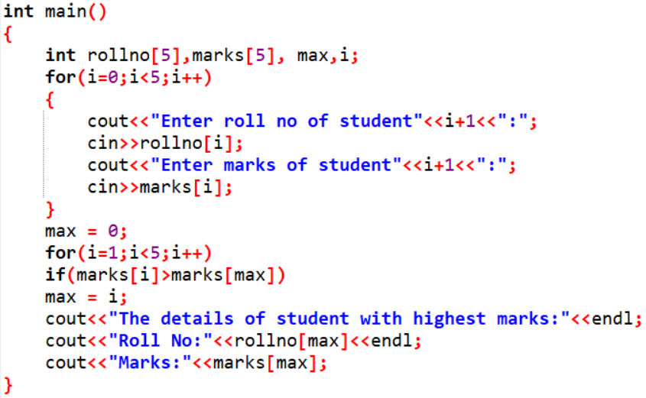

Slide 24
Example
Write a program in C++ to find even and odd number in a given array.

Slide 25
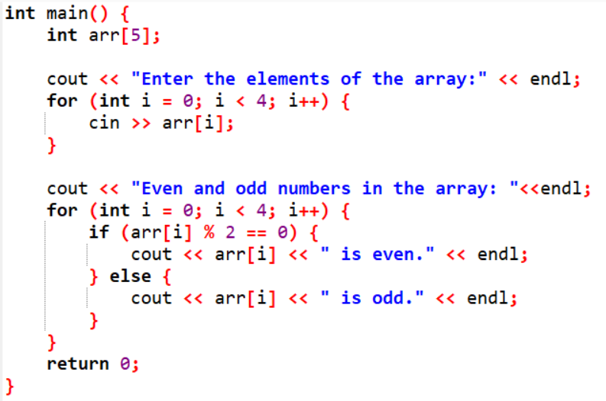

Slide 26
Task
Take 10 numbers from the user in array and find the evensum and oddsum of the number. Finaly display the evensum and oddsum separately.
Notes:
int main() {
int arr[10];
int evensum = 0, oddsum = 0;
cout << "Enter 10 numbers for the array:" << endl;
for (int i = 0; i < 10; i++) {
cin >> arr[i];
}
for (int i = 0; i < 10; i++) {
if (arr[i] % 2 == 0) {
evensum += arr[i];
} else {
oddsum += arr[i];
}
}
cout << "Sum of even numbers: " << evensum << endl;
cout << "Sum of odd numbers: " << oddsum << endl;
return 0;
}

